Slide 1
Algorithm Analysis

Slide 2
Learning Outcomes
Explain the basic techniques for the analysis of algorithms;
Analyze different algorithms in terms of the amount of resource they consume in order to solve problems
Determine when and how to use various data structures including linked lists, queues, stacks, binary trees, and binary search trees
Use different simple and advanced sorting and searching algorithms
Apply the right combination of data structures and algorithms for different information processing tasks.

Slide 3
Definition (Algorithm)
What exactly is an algorithm?
  An algorithm is a clearly specified set of simple instructions to be followed to solve a problem
  Any well-defined computational procedure that takes some value (or set of values called input) as an input and produces some value (or set of values called output) as an output
  A sequence of computational steps that transforms the input into the output
  A set of rules (well-defined, finite) used for calculation or problem solving (for example with computer)

Slide 4
Definition (Algorithm)
What exactly is an algorithm?
  A finite set of instructions that, if followed, accomplishes a particular task
  Is a precise, systematic method for producing a specified result
  Is a tool for solving a well-defined computational problem
    The statement of the problem specifies (in general terms) the desired input/output relationships
    The algorithm describes a specific computational procedure for achieving the input/output relationships

Slide 5
Example Algorithm (1)
The sorting problem
  Statement of the sorting problem
    Input: a sequence of n number <a1, a2, …,an>
    Output: a permutation (reordering) <a1', a2', …,an'> such that a1'≤ a2' ≤ … ≤ an '.
  That is, given an input sequence such as <31, 41, 59, 26, 41, 58> a sorting algorithm returns as an output the sequence <26, 31, 41, 41, 58, 59>

Slide 6
Example Algorithm (1)
A sorting algorithm (insertion sort)
INSERTION-SORT(A)
for j = 2 to length[A]
do key ← A[j]
//insert A[j] to sorted sequence A[1..j-1]
i ← j-1
while i >0 and A[i]>key
do A[i+1] ← A[i] //move A[i] one position right
i ← i-1
A[i+1] ← key

Slide 7
Example Algorithm (2)
Finding the maximum element problem
  Input: an array A storing n integers
  Output: the maximum element in A
  That is, given array A=[31, 41, 26, 41, 58], the maximum algorithm returns 58 which is the maximum element in the array

Slide 8
Example Algorithm (2)
An algorithm for finding the maximum element
Input: An array A storing n integers
Output:The maximum element in A
find_max(A,n):
currentMax A[0]
for i=1 to n-1 Do:
if A[i] > currentMax Theb
currentMax=A[i]
return currentMax

Slide 9
Example Algorithm (3)
Finding the greatest common devisor problem of two natural numbers
  Problem statement
    Determine the greatest common devisor of two natural numbers x and y (where x < y )
  Input
    Two natural numbers a and b
  Output
    The largest natural number d which is the common devisor of a and b

Slide 10
Example Algorithm (3)
Algorithm for finding the greatest common devisor of two natural numbers problem
  Divide y by x with remainder r
  Replace y by x, and x by r
  Repeat step 1 until r is zero
When this algorithm terminates, y is the highest common factor of

Slide 11
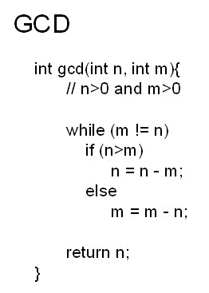
Example Algorithm (3)
GCD(33,21)=3
33 = 1*21 + 12
21 = 1*12 + 9
12 = 1*9 + 3
9 = 3*3

Slide 12
Purpose Algorithm in programs
To accept input
  There are zero or more quantities which are externally supplied
To change values hold by data structures
  It is through an algorithm that you change values
To produce an output
  At least one quantity is produced
To reorganize or reshuffle the data structure
  Sorting
  Deleting an item from the data structure
  Adding an item into the data structure

Slide 13
Properties of Algorithms
Every algorithm possesses the following properties
  I/O
  Finiteness
  Definiteness
  Effectiveness
  Correctness
  Efficiency
  Sequence (sequential)
  simplicity
  Language Independence
  Completeness

Slide 14
Essential Properties of Algorithms
Input specified
  The inputs are the data that will be transformed during the computation to produce the output
  Every algorithm should have a specified number (zero or more) input values (or quantities) which are externally supplied
  We must specify
    the type of data
    The amount of data

Slide 15
Essential Properties of Algorithms
Output specified
  The outputs are the data resulting from the computation (the intended result)
  Every algorithm should have one or more output procedures
  A possible output for some computations is a statement that there can be no output, i.e., no solution is possible, i.e., at least one quantity is produced

Slide 16
Essential Properties of Algorithms
Finiteness (It Must Terminate)
  An algorithm must have the property of finiteness
  That is, every valid algorithm should have finite number of steps
  It must complete after a finite number of steps
  It must eventually stop either with the right output or with a statement that no solution is possible
  If you trace out the instructions of an algorithm, then for all cases the algorithm must terminate after a finite number of steps
  Finiteness is an issue for computer algorithms because if the algorithm doesn’t specify when to stop (computer algorithms often repeat instructions), the computer will continue to repeat the instructions for ever

Slide 17
Essential Properties of Algorithms
Definiteness (Absence of Ambiguity)
  Definiteness means specifying the sequence of operations for transforming the inputs into the outputs
  Algorithms must specify every step
  Every step in the algorithm has to be clearly defined
  Each step must be clearly defined, having one and only one interpretation
  Every detail of each step must be spelled out, including how to handle errors

Slide 18
Essential Properties of Algorithms
Definiteness (Absence of Ambiguity)
  At each point in computation, one should be able to tell exactly what happens next
  It must be composed of concrete steps
  There can be no ambiguity as to which step will be performed
  Definiteness ensures that if the algorithm is performed at different times or by different agents (people or computers) using the same data, the output will be the same

Slide 19
Essential Properties of Algorithms
Effectiveness (Feasibility)
  It must be possible to perform each step exactly and in a finite amount of time.
  It is not enough that each operation be definite as in definiteness, but it must also be feasible
  It must be possible to perform each instruction
  Whereas definiteness specifies which operations to do, effectiveness means that they are doable

Slide 20
Essential Properties of Algorithms
Correctness
  An algorithm must compute correct answer for all possible legal inputs
  Is the most important criteria for evaluating algorithms
  If the algorithm is not doing what it is supposed to do, it is worthless

Slide 21
Essential Properties of Algorithms
Efficiency (focus of this chapter)
  An algorithms should make efficient use of the computer resources
  In particular, we would like an algorithm to run as fast as possible using as little memory as possible
  An algorithm must solve a problem with the least amount of computational resources such as time and space.
  To keep things simple, we will concentrate on the running time of algorithms and will not look at the space (the amount of memory needed)

Slide 22
Essential Properties of Algorithms
Sequential
  Every algorithm should have a beginning (start step) and a halt (end) step
  Between the two every step should halve preceding and succeeding steps
  That is, Each step must have a unique defined preceding and succeeding step
  The first step (start step) and last step (halt step) must be clearly noted

Slide 23
Essential Properties of Algorithms
Simplicity
  We would like our algorithms to be easy to understand and easy to implement
  There often (but not always) a trade of between efficiency and simplicity
  More efficient algorithms tend to be more complicated
  It depends on particular task which of the two criteria is more important

Slide 24
Essential Properties of Algorithms
Language Independence
  It must not depend on any one programming language
Completeness
  must solve the problem completely
Any process having these properties will be called an algorithm

Slide 25
Languages in algorithms
Because algorithms are developed by people, but executed by some other agent, they must be written in some language
The most important requirement of the language is that the person who creates the instructions and the agent that performs them interpret the instructions the same way
An algorithm can be described in many ways
  Natural language
  Programming language
  Pseducode

Slide 26
Analysis of algorithms
What does it mean by analyzing algorithms?
  It means predicting the resources that the algorithm requires
Occasionally, resources such as memory, communication, bandwidth etc are primary concern in analyzing resources that an algorithm requires
Most often, computational time is the primary concern in analyzing resources

Slide 27
Analysis of algorithms
The objective of algorithm analysis is
  to determine how quickly an algorithm executes in practice
  To measure either time or space requirements of an algorithm
What to measure
  Space utilization- amount of memory required
  Time efficiency- amount of time required to process the data

Slide 28
Analysis of algorithms
What to analyze
  The most important recourse to analyze is generally the running time
  Several factors affect the running time of an a program
    Compiler used
    Computer used
    The algorithm used
    The input to the algorithm
  The first two are beyond the scope of theoretical model
  Although thy are important, we will not deal with them in the course
  The last two are the main factors that we deal
  Typically, the size of the input is an important consideration

Slide 29
Analysis of algorithms
Space utilization and Time efficiency depends on many factors
  Size of input
  Speed of machine (computer used)
  Quality of source code (used algorithm)
  Quality of compiler
Focuses on measuring the running time of an algorithm

Slide 30
Running Time of Algorithm
The running time of an algorithm depends on a number of factors
The running time of an algorithm is affected by the factors mentioned in the previous slide
But, for most algorithm, the running time depends on the input
  An already sorted sequence is easier to sort
for most algorithm, the running time depends on size of the input
  Short sequences are easier to sort than long ones
  That is the running time of most algorithms varies with the input and typically grows with the input size

Slide 31
Running Time of Algorithm
Generally, we seek an upper bound on the running time, because everybody likes a guarantee
We can measure the running time of an algorithm in two ways
  Empirically
  Theoretically

Slide 32
Empirical Analysis
What you should do
  Write a program that implements the algorithm
  Run the program with the data sets (the inputs) of varying size and composition
  Use the method like clock() ( or System.CurrentTime.Millis() ) to get an accurate measure of the running time
  Plot the results

Slide 33
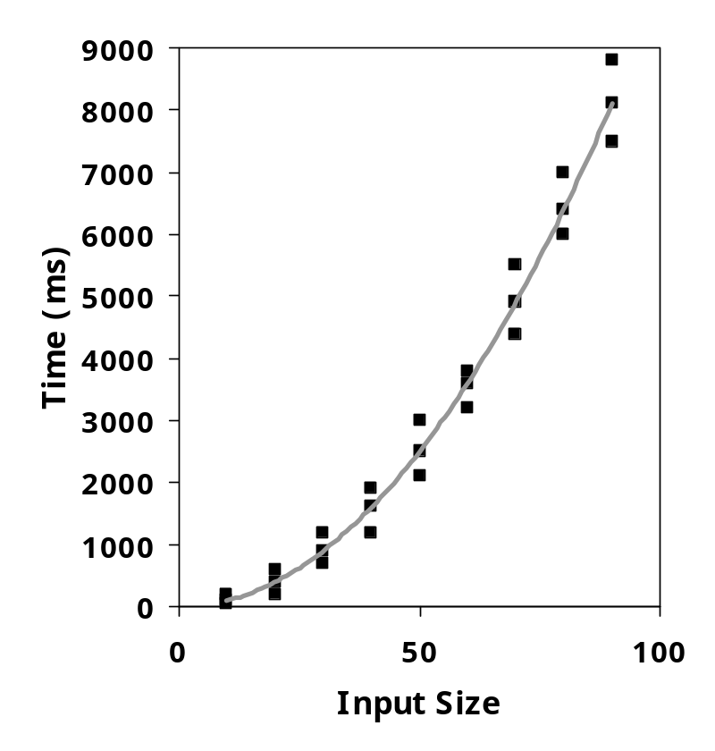
Empirical Analysis
The resulting data set should look something like this

Slide 34
Empirical Analysis
Is an experimental study
The result comes from the running time of the program
It uses system time

Slide 35
Limitations of Empirical Analysis
It can’t be used in estimating the efficiency of algorithms because the result varies due to variations in
  Processor speed
  Input size
  Current processor load
  SW environment
So, in order to compare two algorithms, the same hardware and software environment must be used

Slide 36
Limitations of Empirical Analysis
Involves implementing the algorithm and testing it on various instances
  It is necessary to implement and test the algorithm in order to determine its running time
But, implementing the algorithm may be difficult
This is not the case for theoretical analysis

Slide 37
Limitations of Empirical Analysis
The difficulty to know which instances to test it on
Experiments can be done only on a limited set of inputs, and may not be indicative of the running time on other inputs not included in the experiment
That is, results may not be indicative of the running time on other inputs not included in the experiment

Slide 38
Theoretical Analysis
Is in contrast to the “experimental approach”
Allows us to evaluate the speed (efficiency) of an algorithm in a way that is independent from the HW and SW environment
Is a general methodology for analyzing the running time of an algorithm
Uses a high-level description of the algorithm instead of testing one of its implementation
Takes into account all possible inputs

Slide 39
Theoretical Analysis
Takes an algorithm and produces a function T(n) which depends on the number of operations
That is, running time is expressed as T(n) for some function T on input size n
The output comes from the quantity of resources using mathematical concepts
Does not use system time

Slide 40
Theoretical Analysis
Rather it uses the number of operations (which are expressed in time units) because the number of operations do not vary with
  Processor speed
  Input size
  Current processor load
  SW environment
Theoretical analysis allows us to separate the effect of these factors

Slide 41
Theoretical Analysis
What will be the number of operations for the algorithm below using a computer having
  100 MHZ and 750 MHZ
  Using DOS OS
  Using UNIX OS
  While printing, browsing
for(i=1; i <= 100; i++)
  cout << i;

Slide 42

Theoretical Analysis
Is an approach that can be used to measure or estimate the complexity of an algorithm as the approach do not vary due to variations in the computer systems
The only factor that affects measure of complexity is the input size of the algorithm
To avoid this, measure complexity of algorithm for arbitrary number n as n →

Slide 43
How do measure complexity of algorithms
Two steps or phases for this
  Analysis of algorithm (i.e., theoretical analysis)
  Order of magnitude

Slide 44
How do measure complexity of algorithms
Step one - analysis of algorithm
  At this stage we should have an algorithm or select an algorithm
  By analyzing this algorithm we end up with a function T(n), which is the computing time of an algorithm for input size n
  T(n)= the number of operations of time units
  This first step is used to measure the complexity of the algorithm

Slide 45
Calculating complexity of an algorithm
Step one - analysis of algorithm
  In analyzing an algorithm written in psedocode to determine its complexity, determine the number of operations on the underlying model of computation
  To obtain an estimate of this number, we count primitive operations, chosen to reflect the complexity of the total cost of all operations

Slide 46
Calculating complexity of an algorithm
Step one - analysis of algorithm
  Primitive operations
    Basic computations performed by an algorithm
    Identifiable in pseudocode
    Largely independent from the programming language
    Exact definition not important

Slide 47
Primitive or Basic Operations
Step one - analysis of algorithm
  Examples of basic operations could be
    An assignment (Assigning a value to a variable)
    Calling a method
    Returning from a method
    Evaluating an expression
      An arithmetic operation between two variable (e.g., Performing an arithmetic operations such as addition)
      A Comparison between to variables (two numbers)
      Indexing into an array

Slide 48
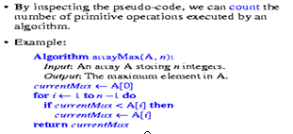
Primitive or Basic Operations

Slide 49
Running time- T(n)
We measure execution (running) time in terms of any of the following
  Arithmetic operations
  Assignment operations
  Loop iterations
  Comparisons
  Procedure calls (calling a method)
  Returning from a method

Slide 50
Order of Magnitude
Refers to the rate at which the storage or time grows as a function of problem size
Input: T(n), the timing function
Output: order of T(n) written as O(T(n))
The output of helps to determine the category to which the algorithm belongs to some known functions (functions whose complexity is known through research and experiment)
Thus, the output is expressed in terms of its relationship to some known functions

Slide 51
Order of Magnitude
This type of analysis is called asymptotic analysis
For large enough inputs, the multiplicative constants and lower-order terms of an exact running time are dominated by the effects of the input size itself
When we look at input sizes large enough to make only the order of growth of the running time relevant, we are studying asymptotic efficiency of algorithms
That is, we are concerned with how the running time of an algorithm increases with the size of the input in the limit, as the size of the input increases without bound
Usually, an algorithm that is asymptotically more efficient will be the best choice for all but very small inputs

Slide 52
More examples on computing T(n) and O(T(n))
If we had to perform all these work every time we need to analyze a program, the task would quickly be infeasible
Since, we are giving the answer in terms of Big-Oh, there are lots of short cuts that can be taken without affecting the final answer
For example- consider example…
  Line 6 is obviously O(1) statement (per execution), so it is silly to count precisely whether it is two, three or four units- it doesn’t matter
  Line 3 is obviously insignificant compared to the four loop, so it is silly to waste time there
This leads to several obvious general rules also called analysis rules

Slide 53
Analysis Rules
These are guidelines for finding out the time complexity of a piece of code
We assume an arbitrary time unit
Unlike real computers, it takes exactly one time unit to do any thing (simple). Thus, execution of one of the following operations takes time one (1)
  assignment statements
  Single input/output statements
  Single Boolean expression evaluation
  Single arithmetic
  function returns

Slide 54
Analysis Rules
Weakness of the above assumption
  In real life, not all operations take exactly the same time
  In our model (i.e., according to the assumption), one disk read counts the same as an addition, even though the addition is typically several orders of magnitude faster

Slide 55
Analysis Rules
If-then-else statement
  The running time of an if-then-else statement is never more than the running time of the test plus the larger of the running times of S1 and S2
    The total time for condition evaluation + the greater complexity of then/else clause
    The total time for condition evaluation + the maximum of the running times for the individual clauses in the selection
    The total time for condition evaluation + max (time taken by alternatives)
  Clearly, this can be an over-estimate in some cases, but it is never an under estimate

Slide 56
Analysis Rules
Example - Running time of if-then- else statement
  If (x>5)
for (i=1; i<=n; i++)
cout << i
else
cout << “hello”;
  Total time = 1 + max (n,1) = 1+ n = O(n)
executed
n times
constant time
constant time

Slide 57
Analysis Rules
Example - Running time of if-then- else statement
Worst-case running time: the test, plus either the then part or the else part (whichever is the larger).
test:
constant
if (depth( ) != otherStack.depth( ) ) {
return false;
}
else {
for (int n = 0; n < depth( ); n++) {
if (!list[n].equals(otherStack.list[n]))
return false;
}
}
then part:
constant
else part:
(constant +
constant) * n
another if :
constant + constant
(no else part)
Total time = c₀ + c₁ + (c₂ + c₃) * n = O(n)

Slide 58
Analysis Rules
Consecutive statements
Add the time complexities of each statement.
These just add (which means that the maximum is the one that counts)
constant time
x = x +1;
for (i=1; i<=n; i++) {
m = m + 2;
}
for (i=1; i<=n; i++) {
for (j=1; j<=n; j++) {
k = k+1;
}
}
executed
n times
constant time
outer loop
executed
n times
inner loop
executed
n times
constant time
Total time = c₀ + c₁n + c₂n² = O(n²)

Slide 59
Analysis Rules
Example - Consecutive statements
This program fragment, which has O(n) work followed by O(n²) work, is also O(n²)
for (int i=0; i<n; i++)
A[i]=0;
for (i=0; i<n; i++)
{
for (int j=0; j<n; j++)
{
A[i] += i + j;
}
}

Slide 60
Analysis Rules
Running time of a Loop statement
The running time of a loop is, at most, the running time of the statements inside the loop (including tests) multiplied by the number of iterations.
for (i=1; i<=n; i++)
{
m = m + 2;
}
executed
n times
constant time
Total time = a constant c * n = cn = O(n)
Always assume the loop executes the maximum number of times

Slide 61
Analysis Rules
Running time of Nested Loop
Analyze inside out
The running time of a statement inside a group of nested loops is the running time of the statement multiplied by the product of the sizes of all the loops
for (i=1; i<=n; i++) {
for (j=1; j<=n; j++) {
k = k+1;
}
}
outer loop
executed
n times
inner loop
executed
n times
constant time
Total time = c * n * n * = cn² = O(n²)
Total running time is the product of the sizes of all the loops.

Slide 62
Analysis Rules
Function call
  Running time of a function call is
    1 + time taken for parameter calculation + time required for the execution of function body (body time)
while loop – analyze like for loop
Switch statement- take the complexity of the most expensive case

Slide 63
Analysis Rules
Example
  Find the complexity of the algorithm below using the analysis rules discussed earlier
  Find the actual complexity for this algorithm and compare it with the result obtained in (a)

Slide 64
1. int count(){ int k=0; cout<< “Enter an integer”; cin>>n; for (i=0;i<n;i++) k=k+1; return 0; } | Time Units to Compute ------------------------------------------------- 1 for the assignment statement: int k=0 1 for the output statement. 1 for the input statement. In the for loop: 1 assignment, n+1 tests, and n increments. n loops of 2 units for an assignment, and an addition. 1 for the return statement. T (n)= 1+1+1+(1+n+1+n)+2n+1 = 4n+6 = O(n)

Slide 65
3. void func() { int x=0; int i=0; int j=1; cout<< “Enter an Integer value”; cin>>n; while (i<n){ x++; i++; } while (j<n) { j++; } } | Time Units to Compute ------------------------------------------------- 1 for the first assignment statement: x=0; 1 for the second assignment statement: i=0; 1 for the third assignment statement: j=1; 1 for the output statement. 1 for the input statement. In the first while loop: n+1 tests n loops of 2 units for the two increment (addition) operations In the second while loop: n tests n-1 increments ------------------------------------------------------------------- T (n)= 1+1+1+1+1+n+1+2n+n+n-1 = 5n+5 = O(n)

Slide 66
2 int total(int n) { int sum=0; for (int i=1;i<=n;i++) sum=sum+1; return sum; } | Time Units to Compute ------------------------------------------------- 1 for the assignment statement: int sum=0 In the for loop: 1 assignment, n+1 tests, and n increments. n loops of 2 units for an assignment, and an addition. 1 for the return statement. T (n)= 1+ (1+n+1+n)+2n+1 = 4n+4 = O(n)

Slide 67
14. int sum (int n) { int partial_sum = 0; for (int i = 1; i <= n; i++) partial_sum = partial_sum +(i * i * i); return partial_sum; } | +(1+n+1+n)+2n+1 = 4n+6 = O(n) Time Units to Compute ------------------------------------------------- 1 for the assignment. 1 assignment, n+1 tests, and n increments. n loops of 4 units for an assignment, an addition, and two multiplications. 1 for the return statement. ------------------------------------------------------------------- T (n)= 1+(1+n+1+n)+4n+1 = 6n+4 = O(n)

Slide 68

Formal Approach to Analysis
For Loops: Formally
  In general, a for loop translates to a summation. The index and bounds of the summation are the same as the index and bounds of the for loop.

Slide 69
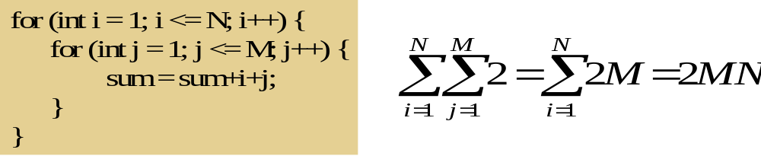
Nested Loops: Formally
  Nested for loops translate into multiple summations, one for each for loop.

Slide 70
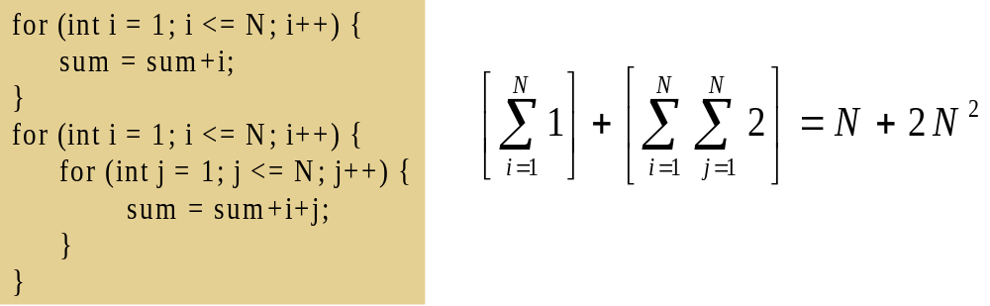
Consecutive Statements: Formally
Add the running times of the separate blocks of your code

Slide 71
Conditionals: Formally
If (test) s1
  else s2:
Compute the maximum of the running time for s1 and s2.

Slide 72

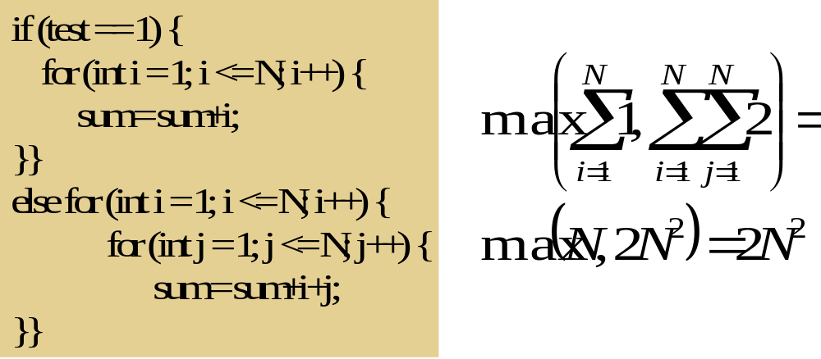

Slide 74
Algorithm Analysis Categories
An algorithm may run faster on certain data sets than others
Algorithms must be examined under different situations to correctly determine their efficiency for accurate comparison
Three categories to analyze algorithms
  Best case
  Worst case
  Average case

Slide 75
Best Case Analysis
Best case is defined as which input of size n is the cheapest among all inputs of size n
Best case is obtained from the in the input data set that results in best possible performance

Slide 76
Best Case Analysis
Input
  Assumes the input data are found in the most advantageous order for the algorithm
  For sorting, the most advantageous order is that data are arranged in the required order
  For searching, the best case is that the required item is found at the first position
  Question
    Which order is the most advantageous for an algorithm that sorts 2 5 8 1 4 (ascending order)
Input size
  Assumes that the input size is the minimum possible

Slide 77
Best Case Analysis
This case executes or causes the fewest number of executions
So, it computes the lower bound of T(n) and You can not do better
Is the amount of time the algorithm takes on the smallest possible set of inputs
Best case behavior is usually not informative and hence usually uninteresting (why?)
The function is denoted by T_{best}(n) – best case running time of an algorithm for n inputs

Slide 78
Worst Case Analysis
Is the complexity of an algorithm based on worst input of each size
Is the amount of time the algorithm takes on the worst possible set of inputs
Is the longest running time for any input of size n

Slide 79
Worst Case Analysis
Input (i.e., arrangement of data)
  Assumes that the data are arranged in the most disadvantageous order
  For sorting, the worst case assumes that data are arranged in opposite order
  For searching, the worst case assumes that the required item is found at last position or missing
Input size
  Assumes the input size to be infinite
  That is, it assumes that the input size is a very large number
  That is, it considers n →infinity

Slide 80
Worst Case Analysis
This case, causes highest number of executions to be performed by the algorithm
So, it computes the upper bound of T(n), the longest running time for any input size n
Commonly used for computing T(n)
Is a function and is denoted by T_{worst}(n) – the worst case running time of the algorithm for n inputs

Slide 81
Worst Case Analysis
Worst case is easier to analyze and can yield useful information
In certain application domains (e.g., air traffic control, surgery) knowing of the worst case time complexity is of crucial importance

Slide 82
Average Case Analysis
Is the complexity of an algorithm averaged over all inputs of each size
Varies between the best case and worst case
Gives the average performance of an algorithm
Computes the optimal (the one which is found most of the time) bound of T(n)
The average case can be as bad as the worst case

Slide 83
Average Case Analysis
Input (i.e., arrangement of data)
  Assumes that data are arranged in random order
  For searching, it assumes that the required item is found at any position or can be missing
  For sorting, it assumes that data are arranged in a random order
Input size
  The input size can be any random number as small as the best case or as large as the worst case

Slide 84
Average Case Analysis
Problems with performing an average case analysis
  It may not be apparent what constitutes an “average” input for a particular problem
    There is no clue as to what can be an average input
    It is difficult to envision the data that would cause an algorithm (e.g., alg. for insertion sort) to exhibit its average behavior
  Average case is difficult to determine

Slide 85
Average Case Analysis
Problems with performing an average case analysis
  The average operation count is often
    Quite difficult to determine or define
    Quite difficult to analyze
  Often we assume that all inputs of a given size are equally likely
    In practice, this assumption may be violated, but randomized algorithms can sometimes force this to hold

Slide 86
Average Case Analysis
As a result, in several of the algorithms, we limit our analysis to determining the best and worst counts
We focus on the worst case running time
  Easier to analyze
  Crucial to applications such as games, finance and robotics

Slide 87
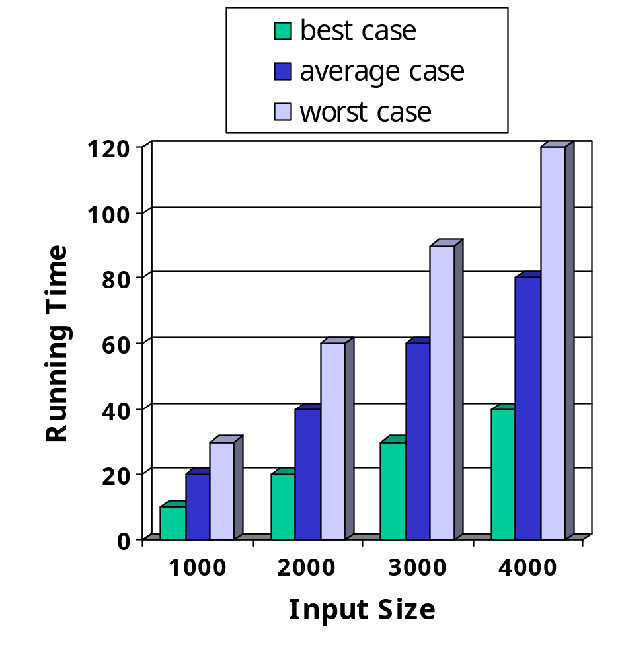
Graphical view of best, average and worst cases
The running time of an algorithm varies with the input and typically grows with the input size

Slide 88
Which Analysis to Use?
Question
  How can we determine the complexity of an algorithm on any data set?
  When is the worst case time important?
Any of these categories have their own pros and cons depending on the data set (arrangement of the data and input size)
  While average time appears to be the fairest measure, it may be difficult to determine
  Typically, the worst case analysis is used to estimate the complexity of an algorithm (That is, we compare algorithms at their worst case)

Slide 89
Why use a worst case analysis
The following are reasons for using worst case analysis as an estimate for the complexity of an algorithm
The worst case running time of an algorithm provides an upper bound on the running time for all inputs (i.e., all cases)
    Thus, there is no bad operation than worst case
    So, knowing it gives us guarantee that the algorithm will never take any longer

Slide 90
Why use a worst case analysis
For some algorithms, the worst case occurs fairly often
  That is , Worst case "may" be a typical case
The average case is often roughly as bad as the worst case
  Average case may be approximately the worst case (( tj = j / 2 ) is roughly quadratic)
Often it is hard to pick average cases and compute expected times.
  The average case bounds are usually more difficult to compute
Conclusion
  Unless otherwise specified, running time is the worst case

Slide 91
Example
Compute the best, average and worst case time complexities of the Insertion sort

Slide 92
Asymptotic Analysis
Asymptotic analysis is concerned with how the running time of an algorithm increases with the size of the input in the limit, as the size of the input increases without bound.
There are five notations used to describe a running time function. These are:
    Big-Oh Notation (O)
    Big-Omega Notation (Ω)
    Theta Notation (Θ)
    Little-o Notation (o)
    Little-Omega Notation (ω)

Slide 93
The Big-Oh Notation
It’s only concerned with what happens for very a large value of n.
Therefore only the largest term in the expression (function) is needed.
Big-Oh is mainly concerned with large values of n
Big-O expresses an upper bound on the growth rate of a function, for sufficiently large values of n.
Formal Definition: f (n)= O (g (n)) if there exist c, k ∊ ℛ⁺ such that for all n≥ k, f (n) ≤ c.g (n).
Examples: The following points are facts that you can use for Big-Oh problems:
    1<=n for all n>=1
    n<=n² for all n>=1
    2^{n} <=n! for all n>=4
    log₂n<=n for all n>=2
    n<=nlog₂n for all n>=2

Slide 94
1. f(n)=10n+5 and g(n)=n. Show that f(n) is O(g(n)).
To show that f(n) is O(g(n)) we must show that constants c and k such that
  f(n) <=c.g(n) for all n>=k
  Or 10n+5<=c.n for all n>=k
  Try c=15. Then we need to show that 10n+5<=15n
  Solving for n we get: 5<5n or 1<=n.
  So f(n) =10n+5 <=15.g(n) for all n>=1.
  (c=15,k=1).

Slide 95
2. f(n) = 3n² +4n+1. Show that f(n)=O(n²).
  4n <=4n² for all n>=1 and 1<=n² for all n>=1
  3n² +4n+1<=3n²+4n²+n² for all n>=1
  <=8n² for all n>=1
  So we have shown that f(n)<=8n² for all n>=1
  Therefore, f (n) is O(n²) (c=8,k=1)

Slide 96
Typical Orders
N | O(1) | O(log n) | O(n) | O(n log n) | O(n²) | O(n³)
1 | 1 | 1 | 1 | 1 | 1 | 1
2 | 1 | 1 | 2 | 2 | 4 | 8
4 | 1 | 2 | 4 | 8 | 16 | 64
8 | 1 | 3 | 8 | 24 | 64 | 512
16 | 1 | 4 | 16 | 64 | 256 | 4,096
1024 | 1 | 10 | 1,024 | 10,240 | 1,048,576 | 1,073,741,824

Slide 97
Exercise:
f(n) = (3/2)n²+(5/2)n-3
Show that f(n)= O(n²)
In simple words, f (n) =O(g(n)) means that the growth rate of f(n) is less than or equal to g(n).

Slide 98
Big-O Theorems
For all the following theorems, assume that f(n) is a function of n and that k is an arbitrary constant.
Theorem 1: k is O(1)
Theorem 2: A polynomial is O(the term containing the highest power of n).
Polynomial’s growth rate is determined by the leading term
If f(n) is a polynomial of degree d, then f(n) is O(n^{d})
In general, f(n) is big-O of the dominant term of f(n).

Slide 99
Theorem 3: k*f(n) is O(f(n))
Constant factors may be ignored
E.g. f(n) =7n⁴+3n²+5n+1000 is O(n⁴)
Theorem 4(Transitivity): If f(n) is O(g(n))and g(n) is O(h(n)), then f(n) is O(h(n)).
Theorem 5: For any base b, log_{b}(n) is O(logn).
All logarithms grow at the same rate
log_{b}n is O(log_{d}n) b, d > 1

Slide 100
Theorem 6: Each of the following functions is big-O of its successors:
k
log_{b}n
n
nlog_{b}n
n²
n to higher powers
2^{n}
3^{n}
larger constants to the nth power
n!
n^{n}
f(n)= 3nlog_{b}n + 4 log_{b}n+2 is O(nlog_{b}n) and )(n²) and O(2^{n})

Slide 101
Properties of the O Notation
Higher powers grow faster
  n^{r} = O( n^{s}) if 0 <= r <= s
Fastest growing term dominates a sum
If f(n) is O(g(n)), then f(n) + g(n) is O(g)
E.g 5n⁴ + 6n3 is O (n⁴)

Slide 102
Exponential functions grow faster than powers, i.e. n^{k} =O( b^{n} ) ,∀b > 1 and k >= 0
E.g. n²⁰ is O( 1.05^{n})
Logarithms grow more slowly than powers
log_{b}n = O( n^{k}) ∀ , b > 1 and k >= 0
E.g. log₂n is O( n^{0.5})

Slide 103
Big-Omega Notation
Just as O-notation provides an asymptotic upper bound on a function, Ω notation provides an asymptotic lower bound.
Formal Definition: A function f(n) is Ω( g (n)) if there exist constants c and k ∊ ℛ+ such that
  f(n) >=c. g(n) for all n>=k.
  f(n)= Ω( g (n)) means that f(n) is greater than or equal to some constant multiple of g(n) for all values of n greater than or equal to some k.

Slide 104
Example: If f(n) =n^{2,} then f(n)= Ω( n)
In simple terms, f(n)= Ω( g (n)) means that the growth rate of f(n) is greater that or equal to g(n).

Slide 105
Theta Notation
A function f (n) belongs to the set of Θ (g(n)) if there exist positive constants c1 and c2 such that it can be sandwiched between c1.g(n) and c2.g(n), for sufficiently large values of n.
Formal Definition: A function f (n) is Θ (g(n)) if it is both O( g(n) ) and Ω ( g(n) ).
In other words, there exist constants c1, c2, and k >0 such that c1.g (n)<=f(n)<=c2. g(n) for all n >= k
If f(n)= Θ (g(n)), then g(n) is an asymptotically tight bound for f(n).
In simple terms, f(n)= Θ (g(n)) means that f(n) and g(n) have the same rate of growth.

Slide 106
Example:
1. If f(n)=2n+1, then f(n) = Θ (n)
2. f(n) =2n² then
f(n)=O(n⁴)
f(n)=O(n³)
f(n)= O (n²)
All these are technically correct, but the last expression is the best and tight one. Since 2n² and n² have the same growth rate, it can be written as f(n)= Θ(n²).

Slide 107
Little-o Notation
Big-Oh notation may or may not be asymptotically tight, for example:
2n² = O(n²)
=O(n³)
f(n)=o(g(n)) means for all c>0 there exists some k>0 such that f(n)<c.g(n) for all n>=k. Informally, f(n)=o(g(n)) means f(n) becomes insignificant relative to g(n) as n approaches infinity.
Example: f(n)=3n+4 is o(n²)
In simple terms, f(n) has less growth rate compared to g(n).
g(n)= 2n² g(n) =o(n³), O(n²), g(n) is not o(n²).

Slide 108
Little-Omega (ω notation)
Little-omega (ω) notation is to big-omega (Ω) notation as little-o notation is to Big-Oh notation. We use ω notation to denote a lower bound that is not asymptotically tight.
Formal Definition: f(n)= ω (g(n)) if there exists a constant no>0 such that 0<= c. g(n)<f(n) for all n>=k.

Slide 109
Example: 2n²=ω(n) but it’s not Ω(n).
Relational Properties of the Asymptotic Notations
Transitivity
if f(n)=Θ(g(n)) and g(n)= Θ(h(n)) then f(n)=Θ(h(n)),
if f(n)=O(g(n)) and g(n)= O(h(n)) then f(n)=O(h(n)),
if f(n)=Ω(g(n)) and g(n)= Ω(h(n)) then f(n)=Ω (h(n)),
if f(n)=o(g(n)) and g(n)= o(h(n)) then f(n)=o(h(n)), and
if f(n)=ω (g(n)) and g(n)= ω(h(n)) then f(n)=ω (h(n)).

Slide 110
Symmetry
f(n)=Θ(g(n)) if and only if g(n)=Θ(f(n)).
Transpose symmetry
f(n)=O(g(n)) if and only if g(n)=Ω(g(n),
f(n)=o(g(n)) if and only if g(n)=ω(g(n)).
Reflexivity
f(n)=Θ(f(n)),
f(n)=O(f(n)),
f(n)=Ω(f(n)).

